Slide 1
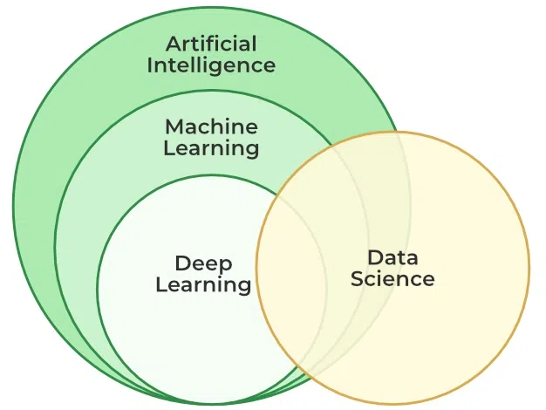
DEEP LEARNING

Slide 2
Contents
Introduction
Concept of convolutional neural network
Types of layers – (Convolutional Layers ,Activation function , pooling , fully connected)
Concept of Convolution (1D and 2D) layers, Training of network
Case study of CNN for eg on Diabetic Retinopathy
Building a smart speaker, Self-deriving car etc.

Slide 3
DEEP LEARNING INTRODUCTION
Deep learning is a subset of machine learning that uses multi-layered neural networks, called deep neural networks, to simulate the complex decision-making power of the human brain.
Some form of deep learning powers most of the artificial intelligence (AI) in our lives today.
By strict definition, a deep neural network, or DNN, is a neural network with three or more layers.
In practice, most DNNs have many more layers.
DNNs are trained on large amounts of data to identify and classify phenomena, recognize patterns and relationships, evaluate possibilities, and make predictions and decisions.

Slide 4
DEEP LEARNING INTRODUCTION
While a single-layer neural network can make useful, approximate predictions and decisions, the additional layers in a deep neural network help refine and optimize those outcomes for greater accuracy.
Deep learning drives many applications and services that improve automation performing analytical and physical tasks without human intervention.
It lies behind everyday products and services—e.g., digital assistants, voice-enabled TV remotes, credit card fraud detection—as well as still emerging technologies such as self-driving cars and generative AI.

Slide 5
Deep learning vs. machine learning
If deep learning is a subset of machine learning, how do they differ?
Deep learning distinguishes itself from classical machine learning by the type of data that it works with and the methods in which it learns.
Machine learning algorithms leverage structured, labeled data to make predictions—meaning that specific features are defined from the input data for the model and organized into tables.
This doesn’t necessarily mean that it doesn’t use unstructured data; it just means that if it does, it generally goes through some pre-processing to organize it into a structured format.

Slide 6
Deep learning vs. machine learning
Deep learning eliminates some of data pre-processing that is typically involved with machine learning.
These algorithms can ingest and process unstructured data, like text and images, and it automates feature extraction, removing some of the dependency on human experts.
For example, let’s say that we had a set of photos of different pets, and we wanted to categorize by “cat”, “dog”, “hamster”, et cetera.
Deep learning algorithms can determine which features (e.g. ears) are most important to distinguish each animal from another.
In machine learning, this hierarchy of features is established manually by a human expert.
Then, through the processes of gradient descent and backpropagation, the deep learning algorithm adjusts and fits itself for accuracy, allowing it to make predictions about a new photo of an animal with increased precision.

Slide 7
Deep learning vs. machine learning
Machine Learning | Deep Learning
Apply statistical algorithms to learn the hidden patterns and relationships in the dataset. | Uses artificial neural network architecture to learn the hidden patterns and relationships in the dataset.
Can work on the smaller amount of dataset | Requires the larger volume of dataset compared to machine learning
Better for the low-label task. | Better for complex task like image processing, natural language processing, etc.
Takes less time to train the model. | Takes more time to train the model.
A model is created by relevant features which are manually extracted from images to detect an object in the image. | Relevant features are automatically extracted from images. It is an end-to-end learning process.
Less complex and easy to interpret the result. | More complex, it works like the black box interpretations of the result are not easy.
It can work on the CPU or requires less computing power as compared to deep learning. | It requires a high-performance computer with GPU.

Slide 8
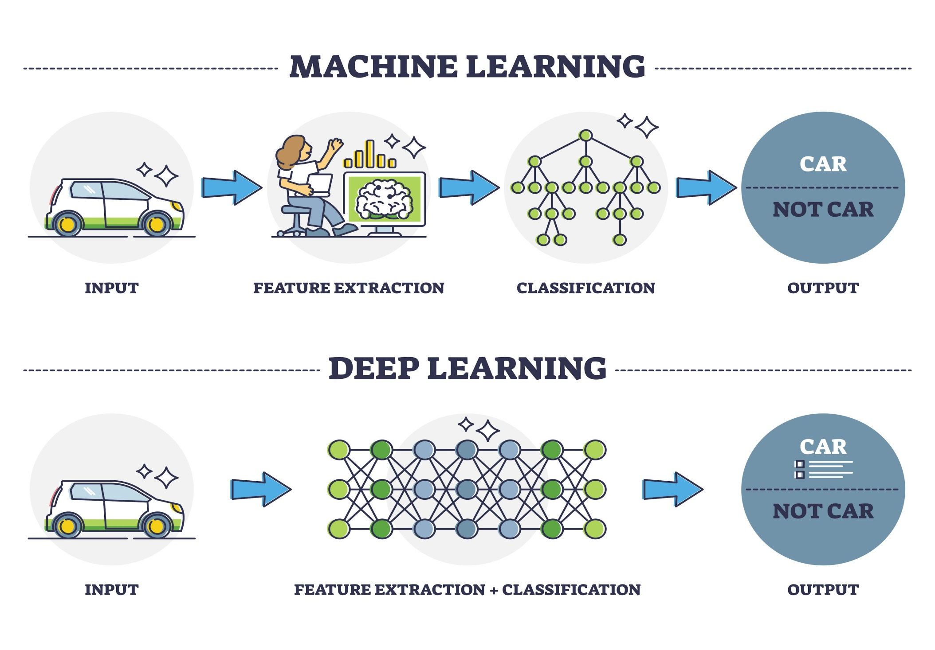
Deep learning vs. machine learning

Slide 9
How deep learning works
Deep learning neural networks, or artificial neural networks, attempts to mimic the human brain through a combination of data inputs, weights, and bias.
These elements work together to accurately recognize, classify, and describe objects within the data.
Deep neural networks consist of multiple layers of interconnected nodes, each building upon the previous layer to refine and optimize the prediction or categorization.
This progression of computations through the network is called forward propagation.
The input and output layers of a deep neural network are called visible layers.
The input layer is where the deep learning model ingests the data for processing, and the output layer is where the final prediction or classification is made.

Slide 10
How deep learning works
Another process called backpropagation uses algorithms, like gradient descent, to calculate errors in predictions and then adjusts the weights and biases of the function by moving backwards through the layers in an effort to train the model.
Together, forward propagation and backpropagation allow a neural network to make predictions and correct for any errors accordingly. Over time, the algorithm becomes gradually more accurate.
Deep learning algorithms are incredibly complex, and there are different types of neural networks to address specific problems or datasets. For example,
Convolutional neural networks (CNNs), used primarily in computer vision and image classification applications, can detect features and patterns within an image, enabling tasks, like object detection or recognition. In 2015, a CNN bested a human in an object recognition challenge for the first time.
Recurrent neural network (RNNs) are typically used in natural language and speech recognition applications as it leverages sequential or times series data.

Slide 11
Applications of Deep Learning
The main applications of deep learning can be divided into computer vision, natural language processing (NLP), and reinforcement learning.
In computer vision, Deep learning models can enable machines to identify and understand visual data. Some of the main applications of deep learning in computer vision include:
Object detection and recognition:
Image classification
Image segmentation
Natural language processing (NLP): In NLP, the Deep learning model can enable machines to understand and generate human language. Some of the main applications of deep learning in NLP include:
Automatic Text Generation
Language translation
Sentiment analysis
Speech recognition

Slide 12
Applications of Deep Learning
Reinforcement learning: In reinforcement learning, deep learning works as training agents to take action in an environment to maximize a reward. Some of the main applications of deep learning in reinforcement learning include:
Game playing: Deep reinforcement learning models have been able to beat human experts at games such as Go, Chess, and Atari.
Robotics: Deep reinforcement learning models can be used to train robots to perform complex tasks such as grasping objects, navigation, and manipulation.
Control systems: Deep reinforcement learning models can be used to control complex systems such as power grids, traffic management, and supply chain optimization.

Slide 13
Applications of Deep Learning
Reinforcement learning: In reinforcement learning, deep learning works as training agents to take action in an environment to maximize a reward. Some of the main applications of deep learning in reinforcement learning include:
Game playing: Deep reinforcement learning models have been able to beat human experts at games such as Go, Chess, and Atari.
Robotics: Deep reinforcement learning models can be used to train robots to perform complex tasks such as grasping objects, navigation, and manipulation.
Control systems: Deep reinforcement learning models can be used to control complex systems such as power grids, traffic management, and supply chain optimization.

Slide 14
Challenges in Deep Learning
Deep learning has made significant advancements in various fields, but there are still some challenges that need to be addressed. Here are some of the main challenges in deep learning:
Data availability: It requires large amounts of data to learn from. For using deep learning it’s a big concern to gather as much data for training.
Computational Resources: For training the deep learning model, it is computationally expensive because it requires specialized hardware like GPUs and TPUs.
Time-consuming: While working on sequential data depending on the computational resource it can take very large even in days or months.
Interpretability: Deep learning models are complex, it works like a black box. it is very difficult to interpret the result.
Overfitting: when the model is trained again and again, it becomes too specialized for the training data, leading to overfitting and poor performance on new data.

Slide 15
Challenges in Deep Learning
Deep learning has made significant advancements in various fields, but there are still some challenges that need to be addressed. Here are some of the main challenges in deep learning:
Data availability: It requires large amounts of data to learn from. For using deep learning it’s a big concern to gather as much data for training.
Computational Resources: For training the deep learning model, it is computationally expensive because it requires specialized hardware like GPUs and TPUs.
Time-consuming: While working on sequential data depending on the computational resource it can take very large even in days or months.
Interpretability: Deep learning models are complex, it works like a black box. it is very difficult to interpret the result.
Overfitting: when the model is trained again and again, it becomes too specialized for the training data, leading to overfitting and poor performance on new data.

Slide 16
Advantages of Deep Learning
High accuracy: Deep Learning algorithms can achieve state-of-the-art performance in various tasks, such as image recognition and natural language processing.
Automated feature engineering: Deep Learning algorithms can automatically discover and learn relevant features from data without the need for manual feature engineering.
Scalability: Deep Learning models can scale to handle large and complex datasets, and can learn from massive amounts of data.
Flexibility: Deep Learning models can be applied to a wide range of tasks and can handle various types of data, such as images, text, and speech.
Continual improvement: Deep Learning models can continually improve their performance as more data becomes available.

Slide 17
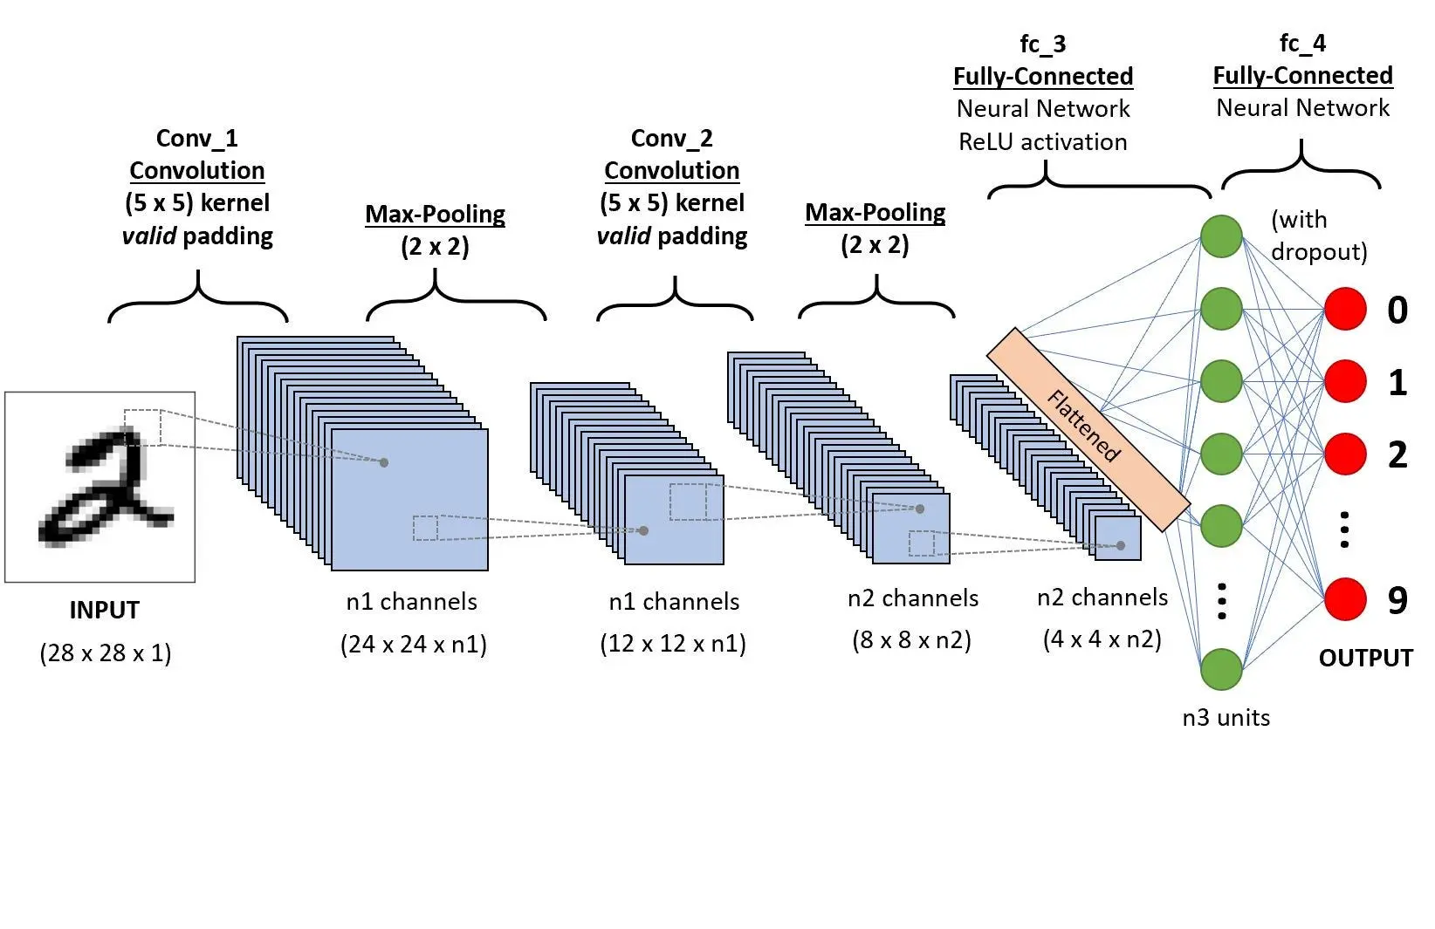
Convolutional Neural Network(CNN)

Slide 18
Concept of convolutional neural network
A Convolutional Neural Network (CNN) is a type of Deep Learning neural network architecture commonly used in Computer Vision.
Computer vision is a field of Artificial Intelligence that enables a computer to understand and interpret the image or visual data.
In a regular Neural Network there are three types of layers i.e. Input, hidden and output layers.
The CNN is extended version of artificial neural networks (ANN) which is predominantly used to extract the feature from the grid-like matrix dataset.
For example visual datasets like images or videos where data patterns play an extensive role.
CNN consists of multiple layers like the input layer, Convolutional layer, Pooling layer, and fully connected layers.

Slide 19
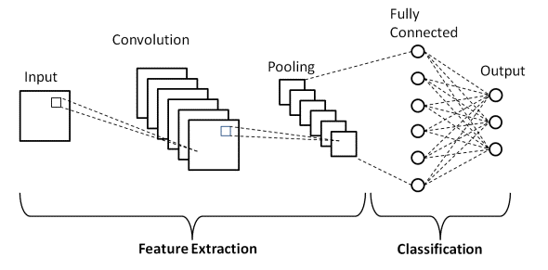
Concept of convolutional neural network
The Convolutional layer applies filters to the input image to extract features.
The Pooling layer down samples the image to reduce computation.
The fully connected layer makes the final prediction.
The network learns the optimal filters through backpropagation and gradient descent.

Slide 20
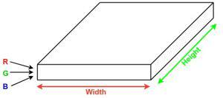
How Convolutional Layers works
Convolution Neural Networks or covnets are neural networks that share their parameters.
Imagine can be represented as a cuboid having its length, width (dimension of the image), and height (i.e the channel as images generally have red, green, and blue channels).

Slide 21
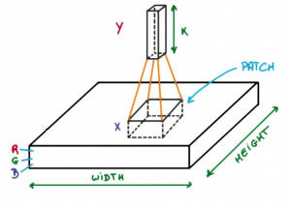
How Convolutional Layers works
Now imagine taking a small patch of this image and running a small neural network, called a filter or kernel on it, with say, K outputs and representing them vertically.
Now slide that neural network across the whole image, as a result, we will get another image with different widths, heights, and depths.
Instead of just R, G, and B channels now we have more channels but lesser width and height. This operation is called Convolution.
If the patch size is the same as that of the image it will be a regular neural network. Because of this small patch, we have fewer weights.

Slide 22
How Convolutional Layers works
Convolution layers consist of a set of learnable filters (or kernels) having small widths and heights and the same depth as that of input volume (3 if the input layer is image input).
For example, if we have to run convolution on an image with dimensions 34x34x3.
The possible size of filters can be axax3, where ‘a’ can be anything like 3, 5, or 7 but smaller as compared to the image dimension.
During the forward pass, we slide each filter across the whole input volume step by step where each step is called stride (which can have a value of 2, 3, or even 4 for high-dimensional images) and compute the dot product between the kernel weights and patch from input volume.
As we slide our filters we’ll get a 2-D output for each filter and we’ll stack them together as a result, we’ll get output volume having a depth equal to the number of filters. The network will learn all the filters.

Slide 23
Layers used to build ConvNets
Let’s take an example by running a covnets on of image of dimension 32 x 32 x 3.
Input Layers:
It’s the layer in which we give input to our model. In CNN, Generally, the input will be an image or a sequence of images.
This layer holds the raw input of the image with width 32, height 32, and depth 3.
Convolutional Layers:
This is the layer, which is used to extract the feature from the input dataset.
It applies a set of learnable filters known as the kernels to the input images.
The filters/kernels are smaller matrices usually 2×2, 3×3, or 5×5 shape.
it slides over the input image data and computes the dot product between kernel weight and the corresponding input image patch.
The output of this layer is referred as feature maps.
Suppose we use a total of 12 filters for this layer we’ll get an output volume of dimension 32 x 32 x 12.

Slide 24
Layers used to build ConvNets
There are three hyperparameters which affect the volume size of the output that need to be set before the training of the neural network begins.
The number of filters affects the depth of the output. For example, three distinct filters would yield three different feature maps, creating a depth of three.
Stride is the distance, or number of pixels, that the kernel moves over the input matrix. While stride values of two or greater is rare, a larger stride yields a smaller output.
Zero-padding is usually used when the filters do not fit the input image. This sets all elements that fall outside of the input matrix to zero, producing a larger or equally sized output. There are three types of padding:
Valid padding: This is also known as no padding. In this case, the last convolution is dropped if dimensions do not align.
Same padding: This padding ensures that the output layer has the same size as the input layer.
Full padding: This type of padding increases the size of the output by adding zeros to the border of the input.

Slide 25
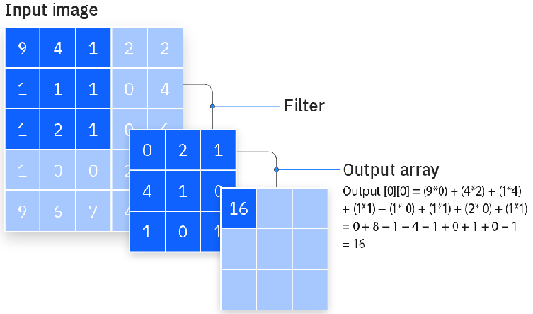
Layers used to build ConvNets
After each convolution operation, a CNN applies a Rectified Linear Unit (ReLU) transformation to the feature map, introducing nonlinearity to the model. Dimension Output=[(Input-Kfilter)/Stride] +1

Slide 26
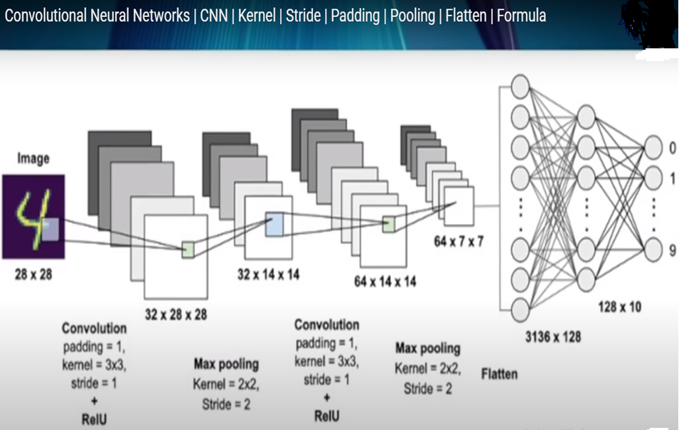
Layers used to build ConvNets

Slide 27
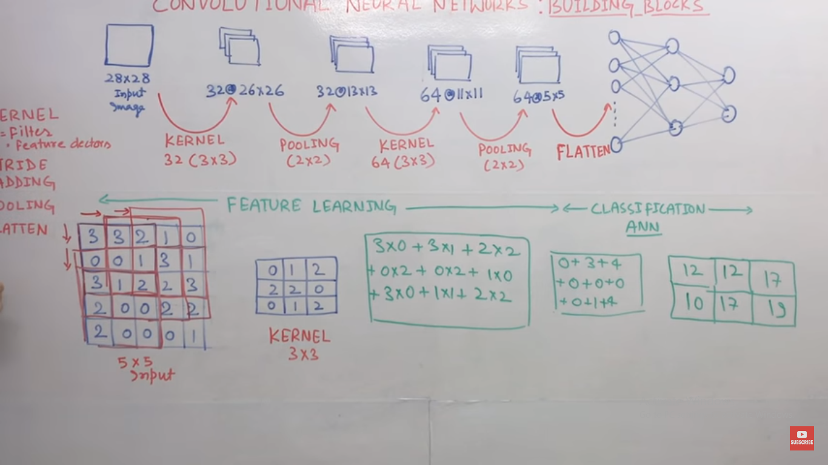
Layers used to build ConvNets

Slide 28
Layers used to build ConvNets
Activation Layer:
By adding an activation function to the output of the preceding layer, activation layers add nonlinearity to the network.
it will apply an element-wise activation function to the output of the convolution layer. Some common activation functions are RELU: max(0, x), Tanh, Leaky RELU, etc.

Slide 29
Layers used to build ConvNets
Pooling layer:
Pooling layers, also known as downsampling, conducts dimensionality reduction, reducing the number of parameters in the input.
Similar to the convolutional layer, the pooling operation sweeps a filter across the entire input, but the difference is that this filter does not have any weights.
Instead, the kernel applies an aggregation function to the values within the receptive field, populating the output array. pooling:
There are two main types of
Max pooling: As the filter moves across the input, it selects the pixel with the maximum value to send to the output array. As an aside, this approach tends to be used more often compared to average pooling.
Average pooling: As the filter moves across the input, it calculates the average value within the receptive field to send to the output array.
While a lot of information is lost in the pooling layer, it also has a number of benefits to the CNN.
They help to reduce complexity, improve efficiency, and limit risk of overfitting.

Slide 30
Layers used to build ConvNets
How Pooling Layers Works
The process of Pooling Layers involves the following steps:
Divide the input data into non-overlapping regions or windows.
Apply an aggregation function, such as max pooling or average pooling, on each window to obtain a single value.
Combine the values obtained from each window to create a downsampled representation of the input data.
Pooling Layers can be applied multiple times in a deep learning model, progressively reducing the spatial dimensions of the feature maps.

Slide 31
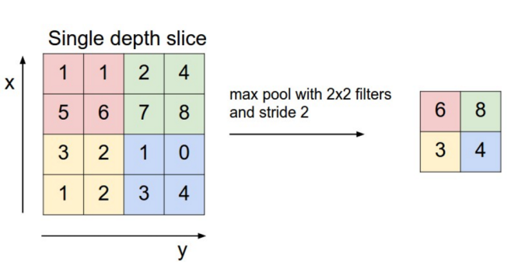
Layers used to build ConvNets
Pooling layer:
This layer is periodically inserted in the covnets and its main function is to reduce the size of volume which makes the computation fast reduces memory and also prevents overfitting.
Two common types of pooling layers are max pooling and average pooling.

Slide 32
Layers used to build ConvNets
The size of the feature map after the pooling layer is:
((l - f + 1) / s) * ((w - f + 1) / s) * c
Here: l = length of the feature map w = width of the feature map f = dimensions of the filter c = number of channels of the feature map s = stride

Slide 33
Layers used to build ConvNets
Why Pooling Layers is Important
Dimensionality Reduction:
By reducing the spatial dimensions of the input data, Pooling Layers help in reducing the number of parameters and computational complexity of the subsequent layers in the model.
Translation Invariance:
Pooling Layers provide a form of translation invariance by extracting the most important features from different spatial locations, making the model more robust to variations in the position of the features.
Feature Hierarchy:
Pooling Layers help in creating a hierarchical representation of the input data, where lower-level features are combined to form higher-level features, capturing abstract representations.
Regularization:
Pooling Layers can act as a form of regularization by reducing overfitting.
By aggregating information from local regions, the model focuses on the most relevant information and ignores minor variations.

Slide 34
Layers used to build ConvNets
Flattening:
The resulting feature maps are flattened into a one-dimensional vector after the convolution and pooling layers so they can be passed into a completely linked layer for categorization or regression.
Fully Connected Layers:
It takes the input from the previous layer and computes the final classification or regression task.
Output Layer:
The output from the fully connected layers is then fed into a logistic function for classification tasks like sigmoid or softmax which converts the output of each class into the probability score of each class.

Slide 35
Concept of Convolution (2D) layers
A 2-D convolutional layer applies sliding convolutional filters to 2-D input.
The layer convolves the input by moving the filters along the input vertically and horizontally and computing the dot product of the weights and the input, and then adding a bias term.
The dimensions that the layer convolves over depends on the layer input:
For 2-D image input (data with four dimensions corresponding to pixels in two spatial dimensions, the channels, and the observations), the layer convolves over the spatial dimensions.
For 2-D image sequence input (data with five dimensions corresponding to the pixels in two spatial dimensions, the channels, the observations, and the time steps), the layer convolves over the two spatial dimensions.
For 1-D image sequence input (data with four dimensions corresponding to the pixels in one spatial dimension, the channels, the observations, and the time steps), the layer convolves over the spatial and time dimensions.

Slide 36
Concept of Convolution (1D) layers
A 1D Convolutional Layer in Deep Learning applies a convolution operation over one-dimensional sequence data, commonly used for analyzing temporal signals or text.
A 1D Convolutional Layer (Conv1D) in deep learning is specifically designed for processing one-dimensional (1D) sequence data.
This type of layer is particularly useful for tasks involving temporal sequences such as audio analysis, time-series forecasting, or natural language processing (NLP), where the data is inherently linear and sequential.
The primary operation in a Conv1D layer involves sliding a convolutional filter (or kernel) across the input sequence.
This filter is a set of learnable weights that the network adjusts during training.
The convolution operation multiplies the values of the filter by the original input values in a segment of the sequence, summing up the results to produce a single output point.
This process is repeated across the entire sequence, generating a transformed sequence as output.

Slide 37
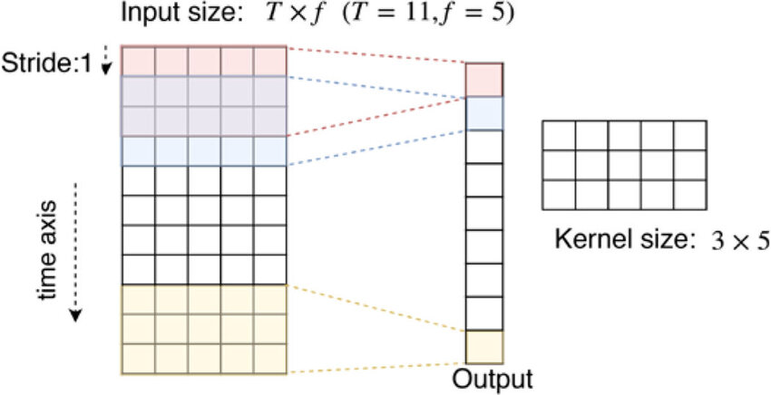
Concept of Convolution (1D and 2D) layers
Feature | Description
Input | 1D sequence data (e.g., time series, text).
Operation | Sliding convolutional filters over the sequence.
Purpose | Extracting high-level features from sequence data.
Applications | Audio signal processing, time-series analysis, NLP.

Slide 38
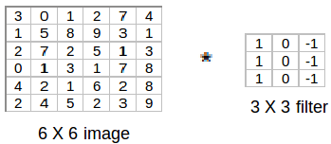
Image Edge Detection

Slide 39
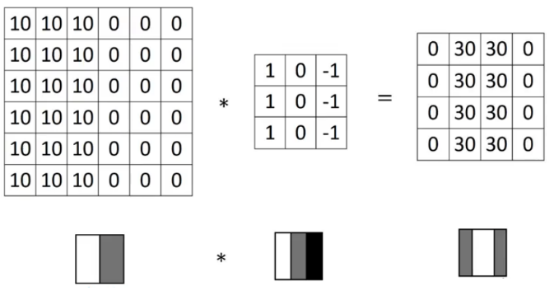
Image Edge Detection

Slide 40
Image Edge Detection
Higher pixel values represent the brighter portion of the image and the lower pixel values represent the darker portions.
This is how we can detect a vertical edge in an image.

Slide 41
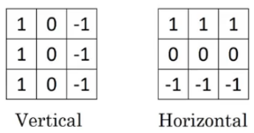
Image Edge Detection

